Slide 1
FlowBy: Android Travel Application
Presented By: Omar Iqbal
Faculty Advisor: Mark Kochanski

Slide 2
What is FlowBy?
FlowBy is an idea I produced while traveling with my family.
I wanted an application that facilitated the organization of travel related needs such as:
Calendar Scheduling
Bookmarking of Attractions
Budget Tracking
Tracking of Personal Belongings
I started development on this in Summer quarter 2019 and worked through Winter 2020.

Slide 3

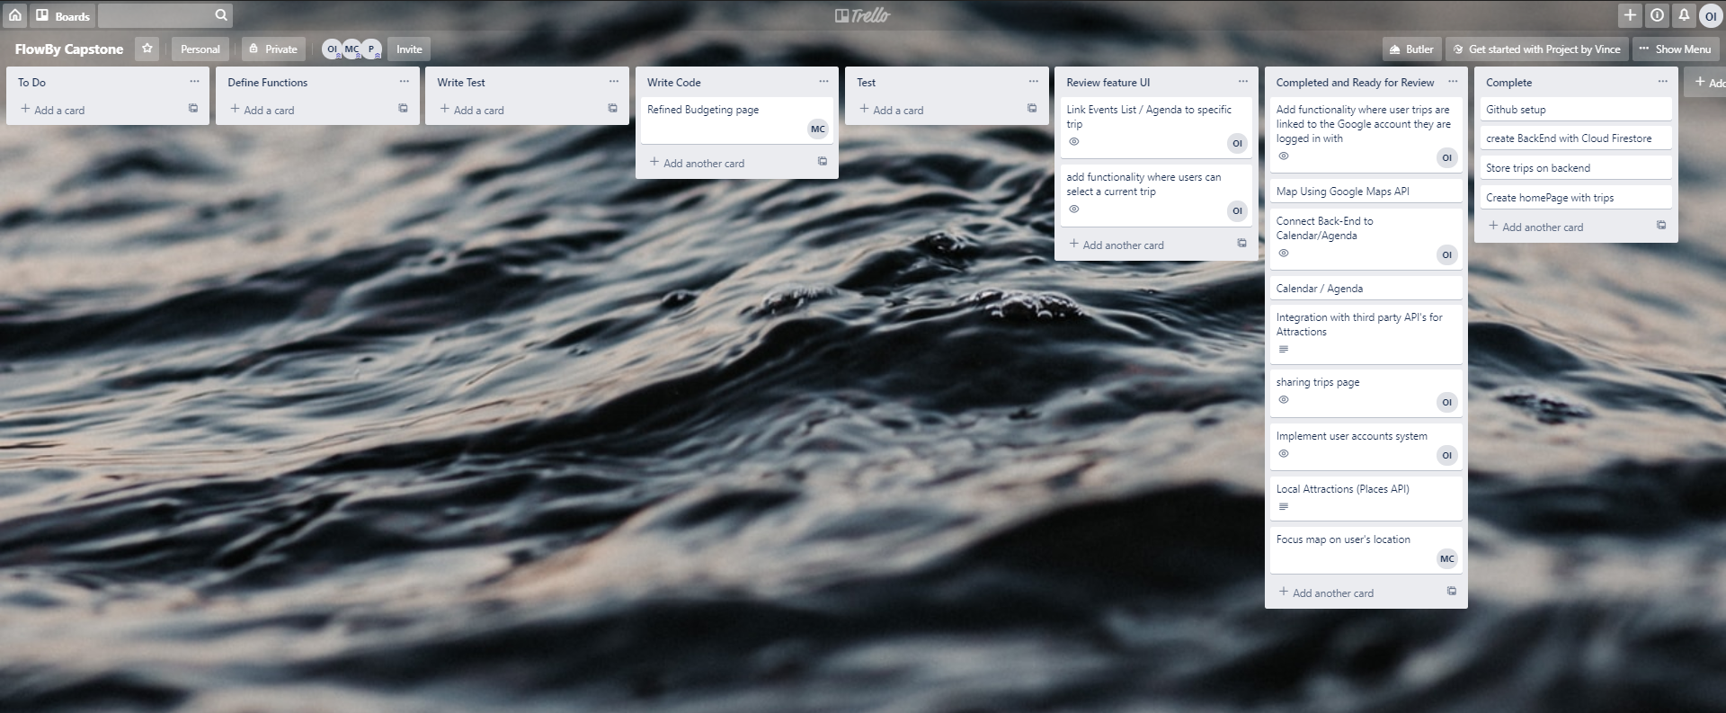
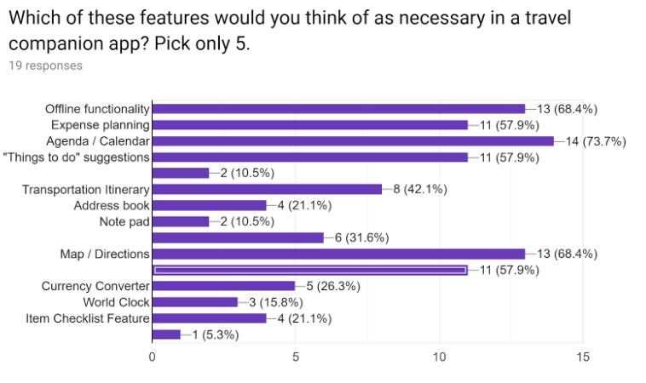
Gathering User Data Through Agile Means

Slide 4
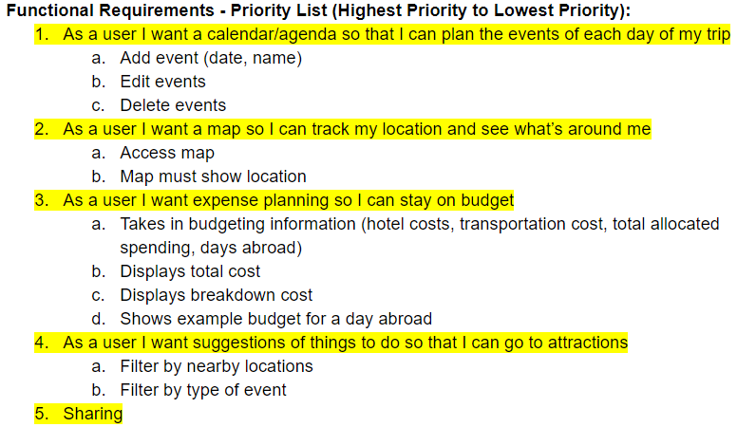
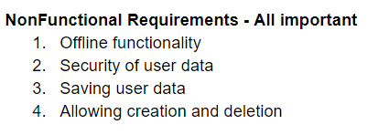
Creating Functional and Non-Functional Requirements with User Stories

Slide 5







Technologies

Slide 6
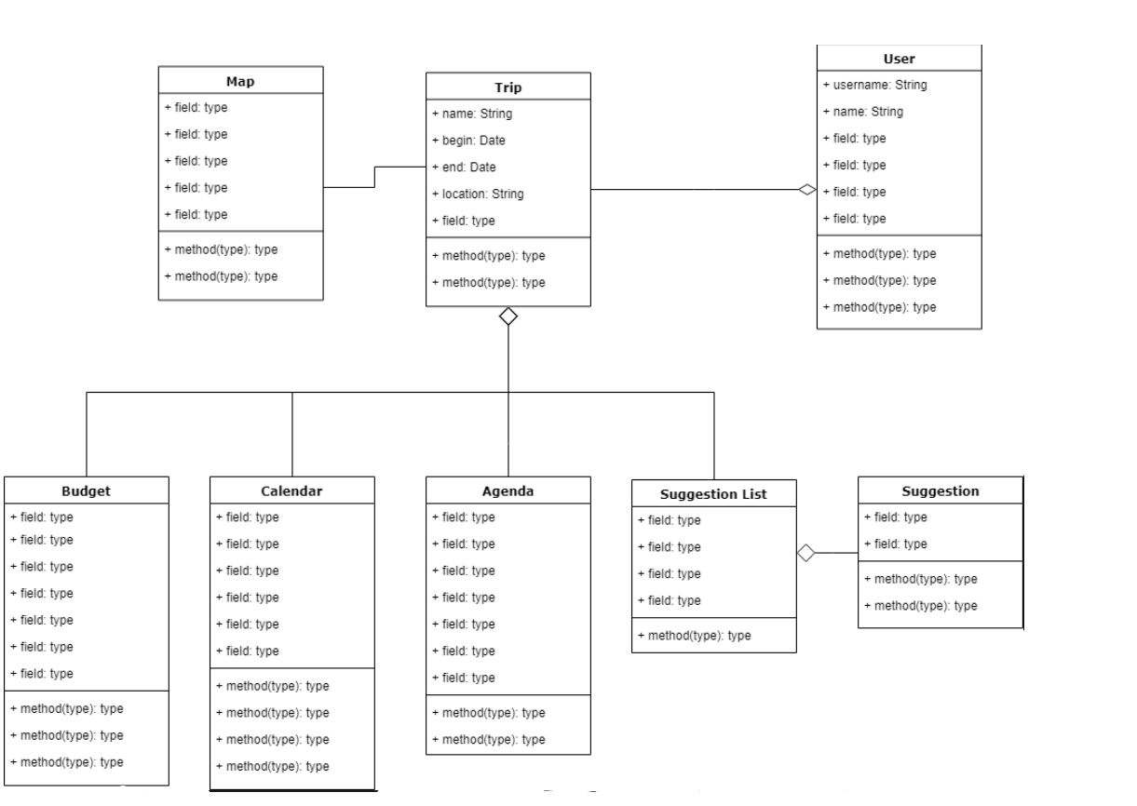
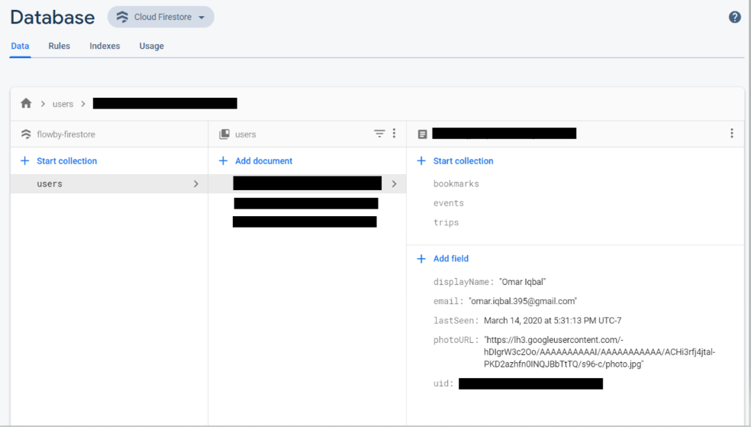
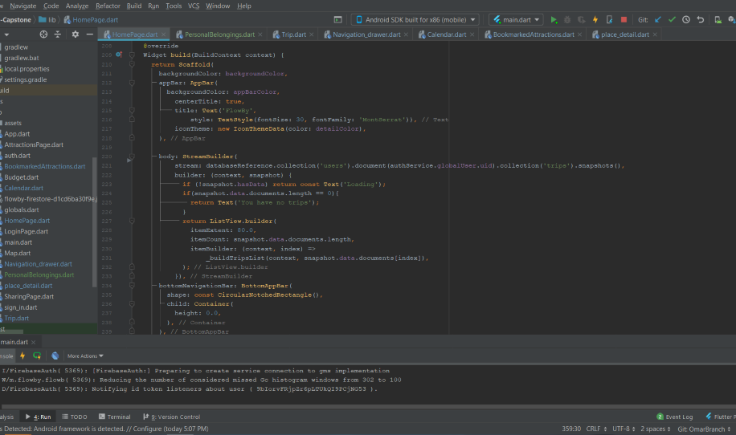
The Development Process
Class Diagram
Sample Code
Firebase Database
Early stage class diagram I created to try and organize the development process
Flutter programming involves the use of “Widgets” and is well integrated with Android Studio
This is the layout of the No-SQL database hosted on Google’s Firebase.

Slide 7
What I’ve Learned & Useful Courses
CSS 342/343 – Data Structures in Algorithms
Programming techniques and terminology
CSS 360 – Software Engineering
Agile methodologies
CSS 436 – Cloud Computing
Knowledge of cloud services and API’s
How to integrate with Cloud Services
Storing and Querying from a NoSQL Database
Gained greater knowledge on Android Development
Learned about all aspects of mobile app development
Icon creation
Back-end databases
Front end UI
Gained insight on how Kanban boards and agile methods are used in practice

Slide 8
